Slide 1

Network Infrastructure Planning for Norris Shai Wealth Management and Advisory
NAME: KONG WAI KIT
STUDENT ID: 051160090
COURSE TITLE: CSN PROJECT

Slide 2
PROJECT BACKGROUND

Slide 3
Company background
Norris Shai Wealth Management and Advisory is one of the dedicated company or agencies of Great Eastern Life Assurance that providing professional financial and insurance planning services to their clients for past 40 years
Hire ten staff to extend business operation.
Segregate all the staff into Human Resource Department, Information Technology Department, Customer Service Department, General Department, and Life Department and have proper way to managing each of the user account
Seeking for privacy and security in order to protect the data against unauthorized.
Looking to have a centralize storage that enable all the staff to access the resources of the company at anytime and anywhere

Slide 4
Problem background
Still using traditional way (hardcopy) to keep customer information
Slow performance of the internet
Do not have proper way or centralize storage to handling the documents that enable the employees to access on it
When government announce FMCO and need to work from home, it is hard to bring the information within the office back to home as all in hardcopy
Exposure of company private and confidential data and information

Slide 5
Project objectives and scope
The network design must meet the need of Norris Shai Wealth Management and Advisory which is the combination of both wired and wireless networks
The configuration of the network design must alongside with the security for the wired as well as well as the wireless networks to protect the company’s data
Design of new network to allow for segregation of network and better security
Configure file server for centralized login and centralized storage for internal staff
Configure the VPN that allow internal staff to access the data and information from home
Configure the wireless network and only allow dedicated agents and customers to access the data and information
Configure the network simulator that used to identify and resolve the problem of the network architecture design

Slide 6
Literature review

Slide 7
introduction
Elements or components that needed of the network design in order to fulfil the expectation and meet the business goal

Slide 8
Overview of ethernet cables for new setup
Cat5e vs Cat6
Bandwidth - CAT6 cable able to handle working frequencies of up to 250 MHz whereas CAT5e is only able handle up to 100 Mhz
Speed - CAT6 cables provides speed of up to 250 MHz which is more than double of the speed of CAT5e lines (100 Mhz)
Crosstalk - CAT6 cables are more flexible than Cat5e
Visual Differences - CAT6 cables are able to be immediately distinguishable as they always employ thicker copper wires than CAT5e cables
Cost - CAT6 cables are around 10% - 20% more expensive than CAT5e cables
Ethernet Cable of Choice
Cat6. Because is more appropriate. Although the price is a little higher and more expensive, but the performance is always worth it

Slide 9
Wired vs wireless network
Mobility – Wired network is less mobility to wireless network
Reliability – Wired network are more reliable to wireless network
Security – Wired network is more secure that wireless network
Wired and Wireless Network - Wired connections for high-speed data transfer on desktops or other non-mobile devices. The smartphones, laptops, or tablets will profit from wireless network
Networking type of choice
Combination of both wired and wireless network because the company are using desktop computers, smartphones and tablets

Slide 10
Ip planning
IP planning entails subnet development and maintenance in addition to IP address assignment, allowing your network and operations to run more efficiently and effectively
IPv4 vs IPv6
IPv4 is an IP version that widely used to identify the devices on a network using an addressing system. It was the first version of IP which deployed for production in the ARPANET during 1983
IPv6 is the latest version of the Internet Protocol. This new IP address version is being implemented in order to meet the need for additional Internet addresses. It was meant to resolve the issues that are related with IPv4
Features of IPv4 - Connectionless Protocol, allow creating a simple virtual communication layer over diversified devices, requires less memory, and ease of remembering addresses, already supported protocol by millions of devices and offers video libraries and conferences
Features of IPv6 - Hierarchical addressing and routing infrastructure, Stateful and Stateless configuration, Stateful and Stateless configuration (QoS) and an ideal protocol for neighboring node interaction

Slide 11
Ip planning
Internet Protocol (IP) of choice
IPv4 because:
Pros of IPv4 vs IPv6
Existing infrastructure - Most of the websites are using IPv4
Simplicity - More easier for people to read
Support - Most of the traffic is still using IPv4

Slide 12
Dynamic host configuration protocol (dhcp)
Is a mechanism that used to configure computer's network settings.
Used to distributes or assign an IP address and other information randomly to each device such as tablets, smartphones, or laptops
Benefit of DHCP
DHCP simplifies IP address management – In fact, DHCP automation simplifies this procedure and makes life easier for both users and network administrators

Slide 13
Domain named server (dns)
The Internet's phonebook is the Domain Name System (DNS), DNS's job is to convert domain names to IP addresses, allowing browsers to access Internet resources
Uses of DNS - Resolving the names of websites on the World Wide Web (WWW), Messages are forwarded to email servers and webmail providers, Within a web application, connecting databases, app servers, and middleware, Virtual Private Networks (VPN), Peer-to-peer sharing programs, Peer-to-peer sharing programs, Instant messaging and online meeting services and Instant messaging and online meeting services
How DNS Work? - The DNS resolution procedure entails translating a hostname (such as www.example.com) into a computer-friendly IP address (like 192.168.1.50)

Slide 14
Domain named server (dns)
Free DNS Server
Google Public DNS - Domain Name System (DNS) service offered to Internet users worldwide by Google
Cloudflare DNS - An enterprise-grade authoritative DNS service that offers the fastest response time, unparalleled redundancy, and advanced security with built-in DDoS mitigation and DNSSEC.
Domain Named Server (DNS) of choice – Cloudflare DNS
Advantages of 1.1.1.1 over 8.8.8.8 – faster, more secure and multiple devices including smartphones and tablets

Slide 15
Network security
Network security is a method or a tool that is created and executed to secure and safeguard a network and its contents
Ensure organization’s online resources remain available
Critical for safeguarding consumer data and information, securing shared data, guaranteeing dependable access and network performance, and defending against cyber-attacks

Slide 16
DeMilitarized zone (dmz)
A demilitarized zone (DMZ) is a perimeter network that prevents illegal traffic from entering an organization's internal local area network (LAN)
Exposes untrusted networks to external-facing services and adds an extra layer of security to secure sensitive and important data on internal networks, as well as filtering traffic across firewalls
Allow an organization to access untrusted networks such as the internet while still preserving the security of its local area network (LAN) or private network

Slide 17
Virtual private network ( vpn)
A Virtual Private Network (VPN) is one of the most significant technologies for protecting businesses against data breaches
Why VPN?
Remote Access – Allows your remote employees to connect to your office network from anywhere they have internet connection
Access Control – Access control is the management of who has access to what
Cybersecurity - A virtual private network (VPN) is a fantastic way to protect your company's data

Slide 18
Virtual private network ( vpn)
How to choose a right VPN?
Security
Reliability and Privacy
Comparison between popular free VPN
OpenVPN Access Server - Is a suite of installation and setup tools that makes it easier to implement a VPN remote access solution quickly
SoftEther VPN - Is a multi-protocol VPN software that is both powerful and simple to use. It's compatible with Windows, Linux, Mac OS X, FreeBSD, and Solaris. SoftEther VPN is a free and open source VPN service
Virtual Private Network of Choice
SoftEther VPN

Slide 19
Virtual local area network (VLAN)
VLAN is extremely useful for organizational usage since it can be used to divide a huge network into smaller portions to improve network management, performance, and security while also lowering IT expenditures
Why VLAN?
Simplified administration for the network manager
Improved security
Easier fault management
Improved quality of service

Slide 20
Wireless network and security
Wireless security is to prevents unauthorized users from accessing a wireless network
Wireless security protocols:
Wired Equivalent Privacy (WEP) - First security protocol that created in 1997
Wi-Fi Protected Access (WPA) - Created to address the vulnerabilities and problems revealed in the WEP protocol
Wi-Fi Protected Access 2 (WPA2) - WPA2 was introduced in 2004 and offered several substantial upgrades as well as new functionality to the wireless security gamut
Wi-Fi Protected Access 3 (WPA3) - WPA3 is introducing the first major changes to the wireless security in 14 years. It provides Greater protection for passwords, Individualized encryption for personal and open networks and More security for enterprise networks
Wireless Network Security of Choice
Wi-Fi Protected Access 2 (WPA2)

Slide 21
router
Serves as the initial line of defense against network intrusion
Best way to keep the information and computer system secure from any attack
Works on the OSI model's Network layer (layer 3) and uses routing tables to figure out where traffic is originating from and where it should go

Slide 22
FIREWALL
A firewall is a network security device or application that monitors and filters incoming and outgoing network traffic in accordance with the organization's previously set security standards
Firewall Security
Layer 3 Firewalls (Network Firewalls) - firewall that set up to allow traffic from specific IP addresses while blocking all other traffic
Layer 7 Firewalls (Application Firewalls) - Assists in sorting traffic according to the application or application service that the traffic is attempting to reach, as well as the traffic's unique contents
Firewall of Choice
Layer 7 Firewall (Application Firewall)

Slide 23
Overview of file server
File server is a centralized server that delivers file systems, or at least sections of a file system, to connect clients
Why using File Server?
Remote Access
Centralized Management of Permissions
Data Security & Backup
Data Recovery Made Easy
Monitor Your Employees
Increase User Control

Slide 24
Overview of file server
Open Source File Server
Seafile
Seafile is a cross-platform open-source cloud storage and synchronization solution that may be self-hosted
Features
Full support for Linux, Windows, Android, macOS, and iOS for cross-platform synchronization
File sharing and permission control
Mobile photo upload

Slide 25
Overview of file server
Open Source File Server
Windows Server
A group of operating systems that designed by Microsoft that used to support enterprise-level management, applications, data storage, and communications.
Concentrated on the stability, networking, security, and the improvement to the file system
Active Directory: User management service within the Windows Server which allows a server to serve as a domain controller
File and Storage: File server for your company, keep important data and information in a central location and allow who to access which files

Slide 26
Overview of file server
File Server of Choice
Windows Server 2022 setting up in the Oracle VM VirtualBox and adapt to Active Directory (AD) to serve as the file server as well as the domain controller

Slide 27
Network simulator
The programme that predicts the performance of a computer network
Network Simulation Tools
Graphical Network Simulator 3
Tool and software that comes in a suitcase and is a form of virtual network
Simulate complex networks and associated scenarios

Slide 28
Network simulator
Network Simulation Tools
Network Simulator 3
Network modelling tool that includes a number of event network simulators
It helps with TCP simulation, multicasting protocols across wireless and wired networks, and routing
Advantages
They respond to clients in a realistic manner while designing real-world systems.
Satellite communications

Slide 29
Network simulator
Cisco Packet Tracer
Help students learn networking principles while also building Cisco-specific skills via hands-on practice
Key Features:
Unlimited devices
Supports majority of networking protocols
Visualizing Networks

Slide 30
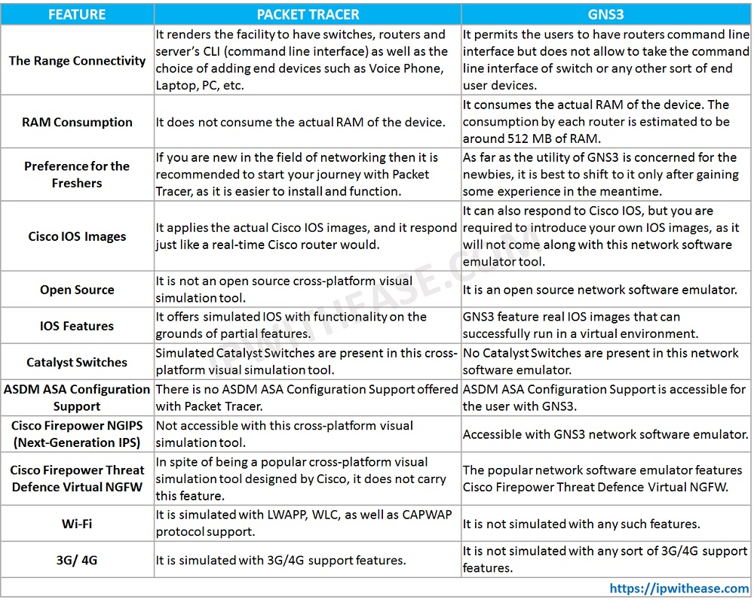
Network simulator
GNS3 vs Cisco Packet Tracer
Network Simulator of Choice
Based on the comparison table, there are
many limitations and requirements to using
Graphical Network Simulator 3. Therefore, Cisco
Packet Tracer could be the better choice for this
project

Slide 31
Methodology for the project
Cisco PPDIOO Lifecycle Methodology
Consist of 6 steps which is Prepare, Plan, Design, Implement, Operate, and Optimize
Lower TCO (total cost of ownership)
Allow to go back previous phase to perform modification

Slide 32
Methodology for the project
Cisco PPDIOO Lifecycle Methodology
Prepare - Determine business's requirements and business's objectives
Plan - Gathering relevant data and identify network requirements
Design - Data from the preceding two stages is gathered and refined to create a complete network architecture
Implement – Implement and built based on design standards
Operate - Preserving the network infrastructure's health through day-to-day operations
Optimize - Identification and resolution of issues

Slide 33
METHODOLOGY AND PROJECT PLAN

Slide 34
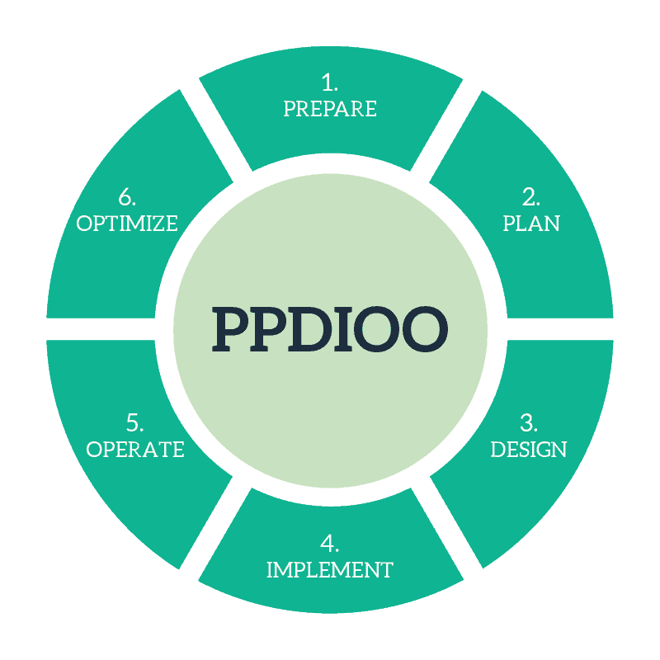
METHODOLOGY
Apply Cisco PPDIOO (Prepare, Plan, Design,
Implement, Operate, and Optimize ) lifecycle
Minimize network cost of ownership
Enhance network agility, speed up access to services
and applications, and boost network availability
Freely return to a prior phase to make modifications

Slide 35
prepare
Visited and interviewed with top management of the company
Established business requirements and identify the problems
Proposed and demonstrated the network structure
Proposed upgrade the internet package

Slide 36
plan
Research and collect the information and resources
Making comparison between:
Cat5e and Cat6
IPv4 and IPv6
Google Public DNS and Cloudflare DNS
OpenVPN Access Server and SoftEther VPN
Wired Equivalent Privacy (WEP), Wi-Fi Protected Access (WPA), Wi-Fi Protected Access 2 (WPA2) and Wi-Fi Protected Access 3 (WPA3)
Layer 3 Firewalls (Network Firewalls), Layer 7 Firewalls (Application Firewalls)
Seafile and Windows Server
Network Simulator 3 and Cisco Packet Tracer

Slide 37
plan
Explain the needed of:
DHCP
DMZ
Security for LAN and Wireless Network
VLAN

Slide 38
design
Refine business requirements
Decide the components for the design:
Unifi Business 100Mbps
Cat6 ethernet cable
SoftEther VPN
IPv4
Cisco Packet Tracer
Layer 7 Firewall (TinyWall)

Slide 39
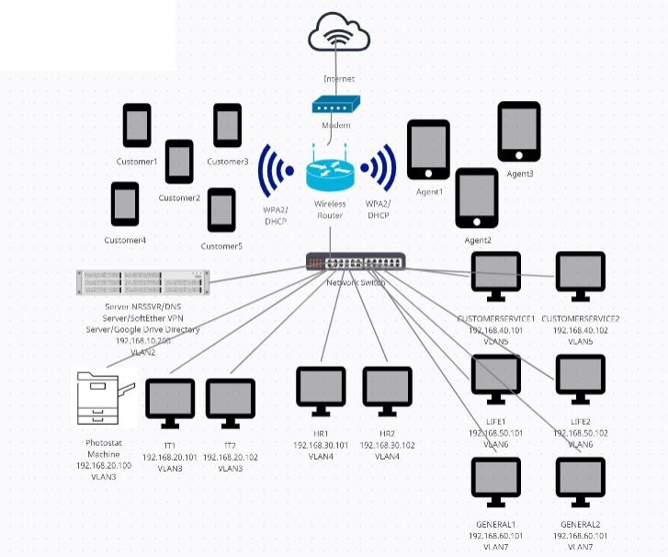
design
Decide the components for the design:
Windows Server 2022 with Active Directory
Wi-Fi Protected Access 2 (WPA2)
Google Drive
VLAN
Cloudflare DNS
Develop and deploy the comprehensive
network design

Slide 40
implement
Build the network design based on components that has been allocated based on the comprehensive network design
Configure, allocate, implement and setup the components that listed in design phase which is:
IPv4 address
DHCP
Cloudflare DNS
VLAN
SoftEther VPN Server and Client
Layer 7 Firewall (TinyWall)
Wi-Fi Protected Access 2 (WPA2)
Google Drive
Windows Server 2022 with Active Directory
Cisco Packet Tracer

Slide 41
Operate
Monitor the network design day by day
Collect the feedbacks and reviews of the users
Generated a report based on the feedback and review
User review that the system is acceptable as expected

Slide 42
OPtimize
Perform modifying and troubleshooting the network design based on the feedbacks and reviews
Recommendation and future work
Using of VPN router
Quality of Server (QoS)

Slide 43
Project plan
TASK | START | END | Duration
Selection Type Of Project | Fri, 23/4/2021 | Thu, 29/4/2021 | 6
Meeting With Supervisor | Fri, 30/4/2021 | Sun, 02/5/2021 | 2
Prepare Phase | Mon, 03/5/2021 | Wed, 26/5/2021 | 23
Interview With Top Management | Mon, 03/5/2021 | Mon, 10/5/2021 | 7
Establish Business Requirement | Mon, 03/5/2021 | Mon, 10/5/2021 | 7
Confirmation Of Project Type | Tue, 11/5/2021 | Wed, 26/5/2021 | 15
Planning Phase | Thu, 27/5/2021 | Thu, 01/7/2021 | 35
Identify Network Requirement | Thu, 27/5/2021 | Thu, 03/6/2021 | 7
Allocate Resources | Fri, 04/6/2021 | Mon, 14/6/2021 | 10
Finalize Network Plan | Tue, 15/6/2021 | Thu, 01/7/2021 | 16
Meeting With Supervisor | Fri, 02/7/2021 | Sun, 04/7/2021 | 2
Submission Of TMA1 | Mon, 05/7/2021 | Tue, 06/7/2021 | 1
Demonstrate each one every task that has been
done as well as the duration that required for the
entire project
Meet with my project supervisor Mr. HO HSIAO
FOONG @ HO HSIEH HSIUNG to discuss about
the type of project that suitable
Kindly refer to Methodology for the detail
prepare phase to optimize phase

Slide 44
Project plan
Gather and Refine Informations | Wed, 07/7/2021 | Wed, 14/7/2021 | 7
Meeting With Supervisor | Thu, 15/7/2021 | Sat, 17/7/2021 | 2
Design Phase | Sun, 18/7/2021 | Tue, 21/9/2021 | 65
Comprehensive Network Design | Sun, 18/7/2021 | Mon, 30/8/2021 | 43
Checking Of Specifications | Tue, 31/8/2021 | Mon, 20/9/2021 | 20
Implement Phase | Tue, 21/9/2021 | Mon, 15/11/2021 | 55
Setup Test Bed | Tue, 21/9/2021 | Fri, 01/10/2021 | 10
Identify Problem | Sat, 02/10/2021 | Tue, 12/10/2021 | 10
Solve the Problem | Wed, 13/10/2021 | Sun, 31/10/2021 | 18
Full-Scale Implementation | Mon, 01/11/2021 | Tue, 16/11/2021 | 15
Meeting With Supervisor | Wed, 17/11/2021 | Fri, 19/11/2021 | 2
Submission Of TMA2 | Sat, 20/11/2021 | Sun, 21/11/2021 | 1
Kindly refer to Methodology for the detail of
prepare phase to optimize phase

Slide 45
Project plan
Kindly refer to Methodology for the detail
prepare phase to optimize phase
Meeting With Supervisor | Tue, 30/11/2021 | Thu, 02/12/2021 | 2
Deploy Network Design | Mon, 22/11/2021 | Mon, 29/11/2021 | 7
Operate Phase | Fri, 03/12/2021 | Sat, 22/1/2022 | 50
Performance Monitoring | Fri, 03/12/2021 | Fri, 07/1/2022 | 35
Fault Detection | Fri, 03/12/2021 | Fri, 07/1/2022 | 35
Making Correction | Sat, 08/1/2022 | Sat, 22/1/2022 | 14
Optimize Phase | Sun, 23/1/2022 | Fri, 04/3/2022 | 40
Identify Issue | Sun, 23/1/2022 | Tue, 22/2/2022 | 30
Resolve Issue | Sun, 23/1/2022 | Tue, 22/2/2022 | 30
Gather Result and Generate Final Report | Wed, 23/2/2022 | Sun, 13/3/2022 | 18
Meeting With Supervisor | Mon, 14/3/2022 | Wed, 16/3/2022 | 2
Submission Of TMA3 | Thu, 17/3/2022 | Fri, 18/3/2022 | 1
End Of Project | Sat, 19/3/2022 | Sun, 20/3/2022 | 1

Slide 46
Development tools
Ethernet Cat6 cable – Connect to all the desktop computer for the internal staff, photostat machine and server NRSSVR
Canon Photostat Machine imageRUNNER ADVANCE iR-ADV C2220 – Perform printing, copying and scanning the documents
Lenovo ThinkCentre Desktop Computer Intel(R) Core(TM) i5-4460 CPU @ 3.20GHz for both Windows 10 Pro and Windows Server 2022 – Desktop computer that contain Window 10 Pro that used to setup VirtualBox and Window Server 2022

Slide 47
Development tools
Cisco Packet Tracer 7.2 64Bit – Simulate the new network architecture of Norris Shai Wealth Management and Advisory
Tinywall 3.2 – Protect the data and information that store in Server NRSSVR
VirtualBox 6.1 – Application that used to setup Window Server 2022
Window 10 Pro – Serve as domain user of internal staff that access the data in Server NRSSVR
Windows Server 2022 and AD (Active Directory) – Setup in VirtualBox that serve as file directory for domain user to access as well as the information for dedicated agents and customers

Slide 48
Development tools
Softether-vpnserver_vpnbridge-v4.38-9760-rtm-2021.08.17-windows-x86_x64-intel – Setup in Server NRSSVR that allow vpn client to connect
Softether-vpnclient-v4.38-9760-rtm-2021.08.17-windows-x86_x64-intel – Setup in domain user’s desktop computer that used to connect the vpn server
Google Drive – To allow dedicated agents and customers to access their information

Slide 49
Result and review
Deploy the network design to the company
Collect feedback and review after use
Logical view - Network architecture that only see by the network administrator
Physical view - Actual result which truly seeing and able to perform testing by the end user and network administrator.

Slide 50
Research and result development
Discussion and analysis base on the testing results
Testing results is focusing on analysis the information into a data
Moving to optimize phase after all the thing ready
Important to figure out needs of user in the company and to fulfil business goal in future

Slide 51
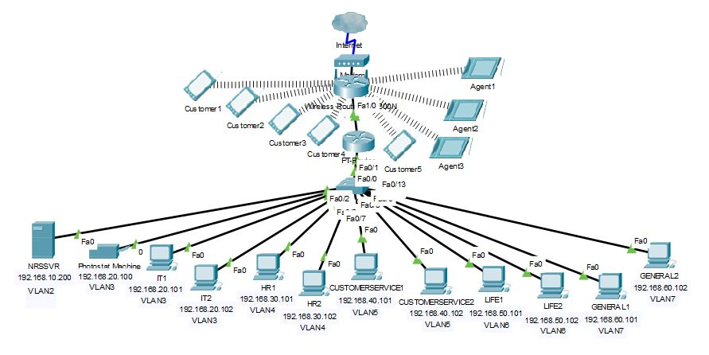
New network architecture
Logical View
Network Architecture
Design of Norris Shai
Wealth Management and
Advisory

Slide 52
New network architecture
VLAN and static IP address group for respective departments
Department | VLAN Group | IP Ranges
SERVER | VLAN2 | 192.168.10.x
IT | VLAN3 | 192.168.20.x
HR | VLAN4 | 192.168.30.x
CUSTOMER-SERVICE | VLAN5 | 192.168.40.x
LIFE | VLAN6 | 192.168.50.x
GENERAL | VLAN7 | 192.168.60.x

Slide 53
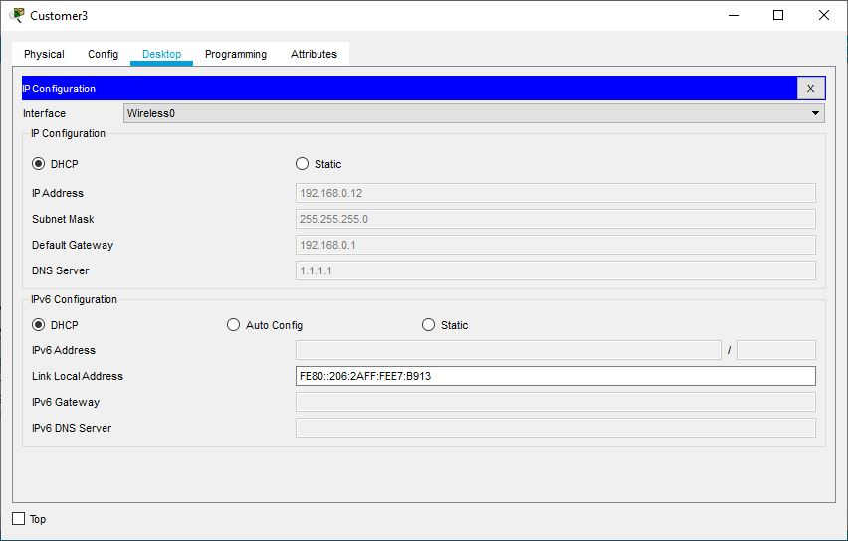
New network architecture
Customer3 is able to connect the
wireless network, the wireless router is automatically assign DHCP, Subnet Mask, Default Gateway and Cloudflare DNS to the device

Slide 54
New network architecture
Department ID for respective departments
Department ID | Department
20 | INFORMATION TECHNOLOGY
30 | HUMAN RESOURCE
40 | CUSTOMER SERVICE
50 | GENERAL
60 | LIFE

Slide 55
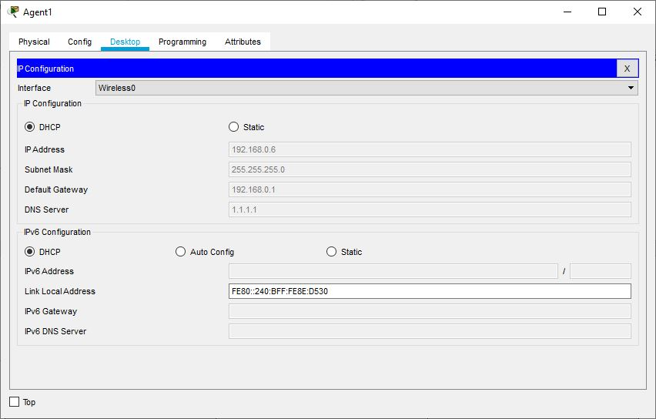
New network architecture
Agent1 is able to connect the wireless network, the wireless router is automatically assign DHCP, Subnet Mask, Default Gateway and Cloudflare DNS to the device

Slide 56
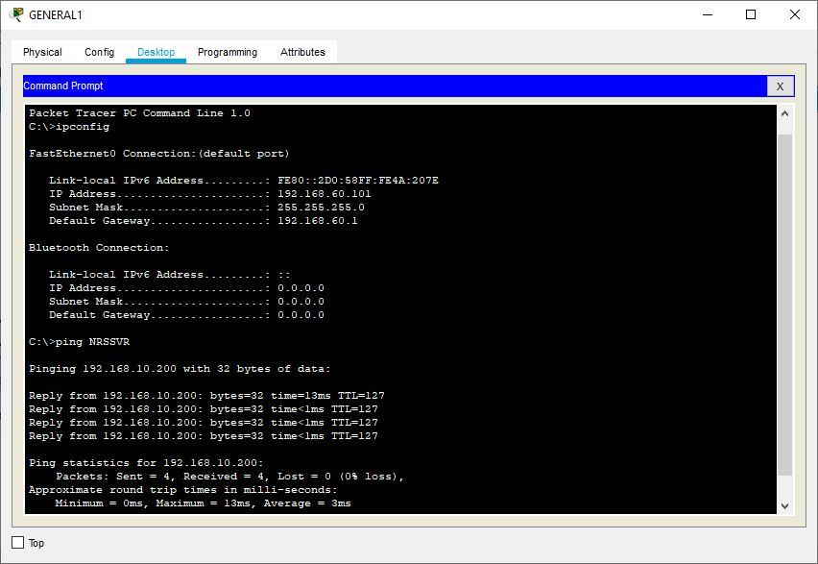
New network architecture
GENERAL1 IP :
192.168.60.101 (VLAN7)
NRSSVR IP :
192.168.10.200 (VLAN2)
GENERAL1 is able to connect to Server NRSSVR

Slide 57
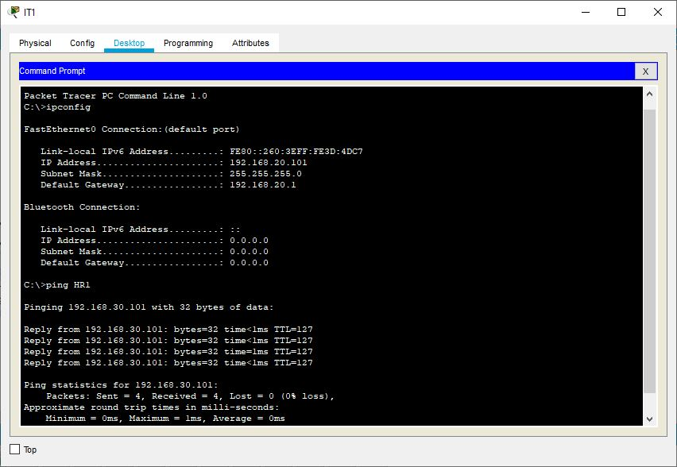
New network architecture
IT1 IP : 192.168.20.101 (VLAN3)
HR1 IP : 192.168.30.101 (VLAN4)
IT1 is connect to HR1 each other

Slide 58
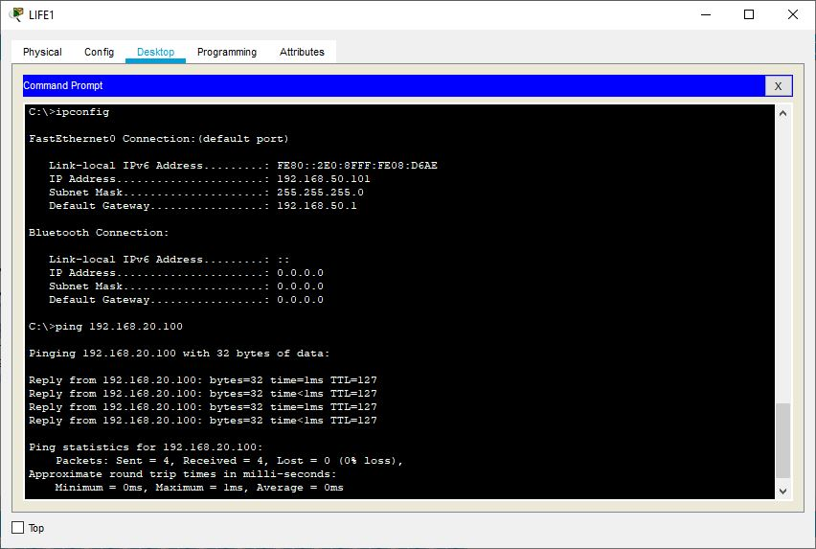
New network architecture
LIFE1 IP :
192.168.50.101 (VLAN6)
Photostat Machine IP : 192.168.20.100 (VLAN3)
LIFE1 connect to the Photostat Machine

Slide 59
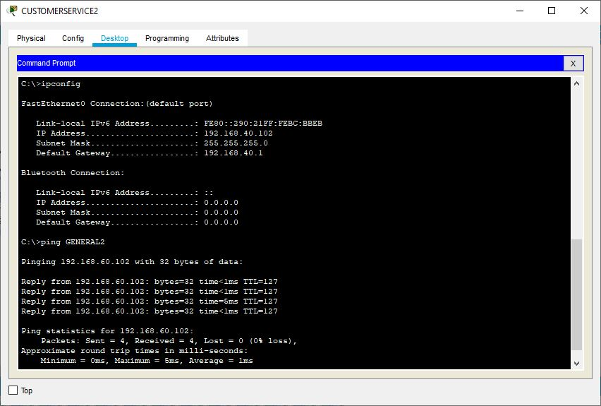
New network architecture
CUSTOMERSERVICE2 IP : 192.168.40.102 (VLAN5)
GENERAL2 IP :
192.168.60.102 (VLAN7)
CUSTOMERSERVICE2 is connect to GENERAL2 to each other

Slide 60
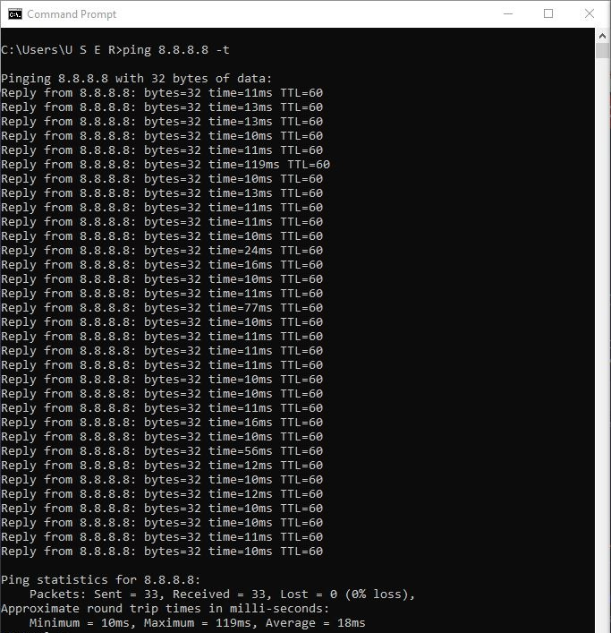
New network architecture
Ping test of the network of Unifi Business 100Mbps is connect smoothly without single packet loss

Slide 61
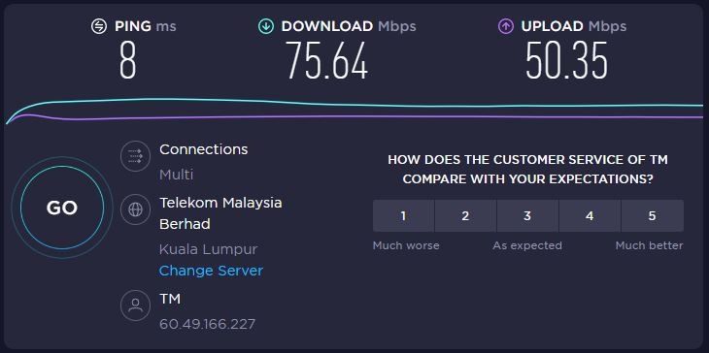
New network architecture
Speed test of the network performance improve dramatically after change to Unifi Business 100Mbps.

Slide 62
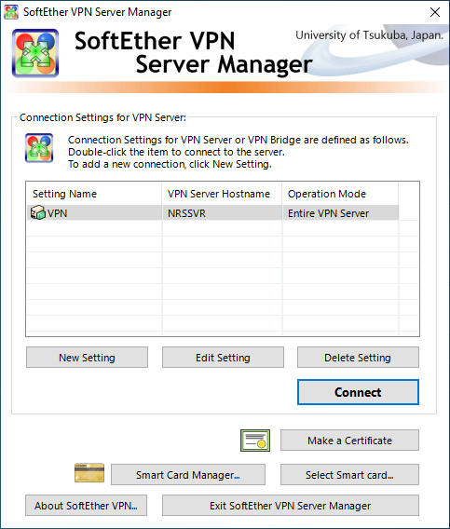
New network architecture
Physical View
User interface of SoftEther VPN Server

Slide 63
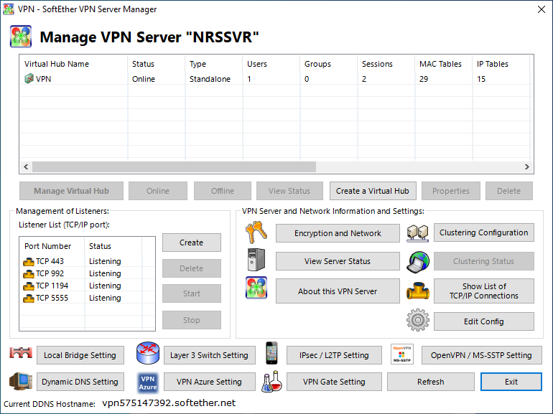
New network architecture
SoftEther VPN Server is connected

Slide 64
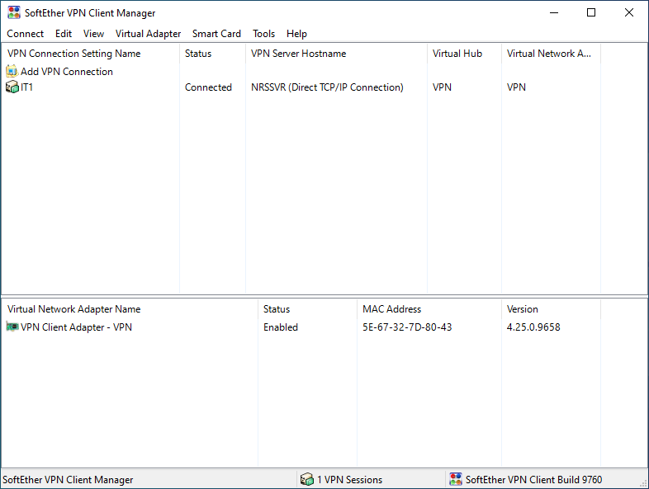
New network architecture
Connection between SoftEther VPN Client and SoftEther VPN Server is established

Slide 65
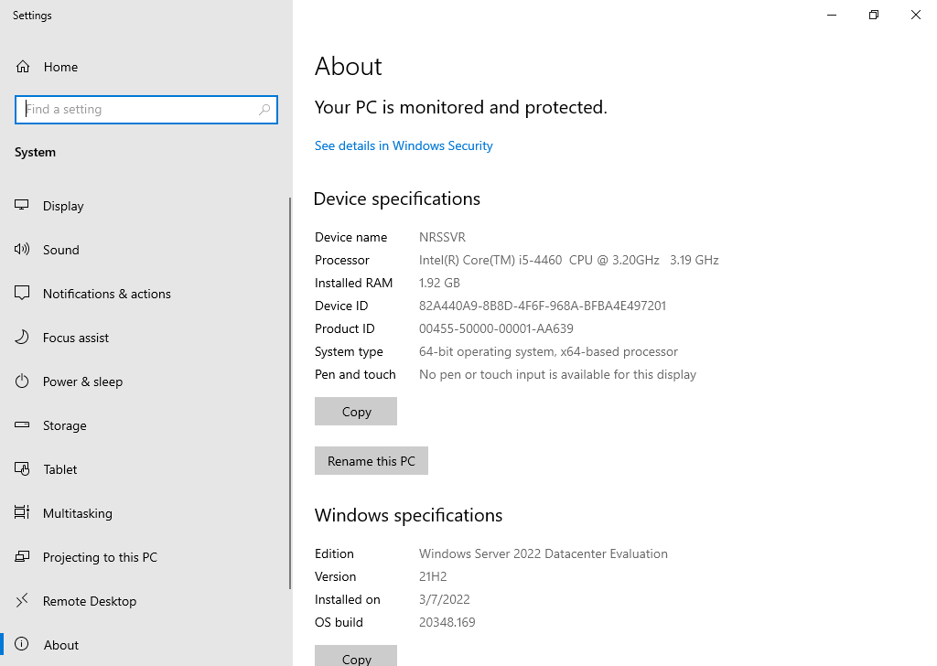
New network architecture
Specification of Server (NRSSVR)

Slide 66
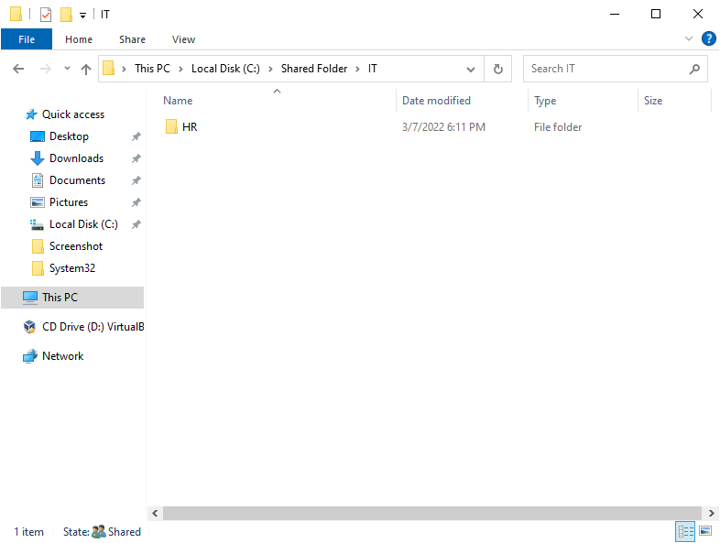
New network architecture
Shared folder location for each of the department within the Server NRSSVR

Slide 67
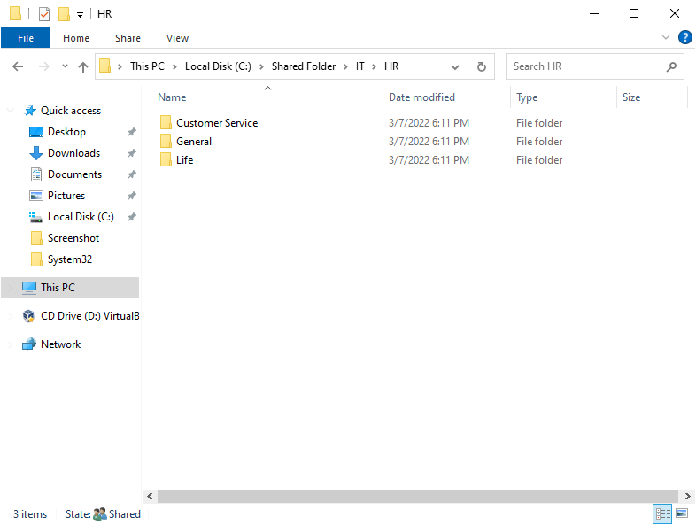
New network architecture
Shared folder location for each of the department within the Server NRSSVR

Slide 68
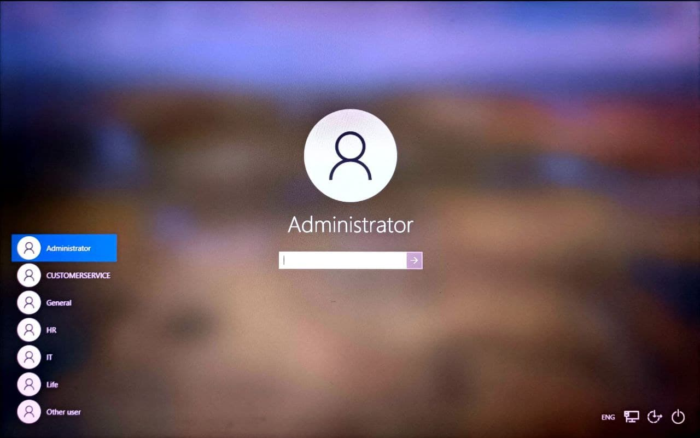
New network architecture
Login user interface for the domain user for each of the department

Slide 69
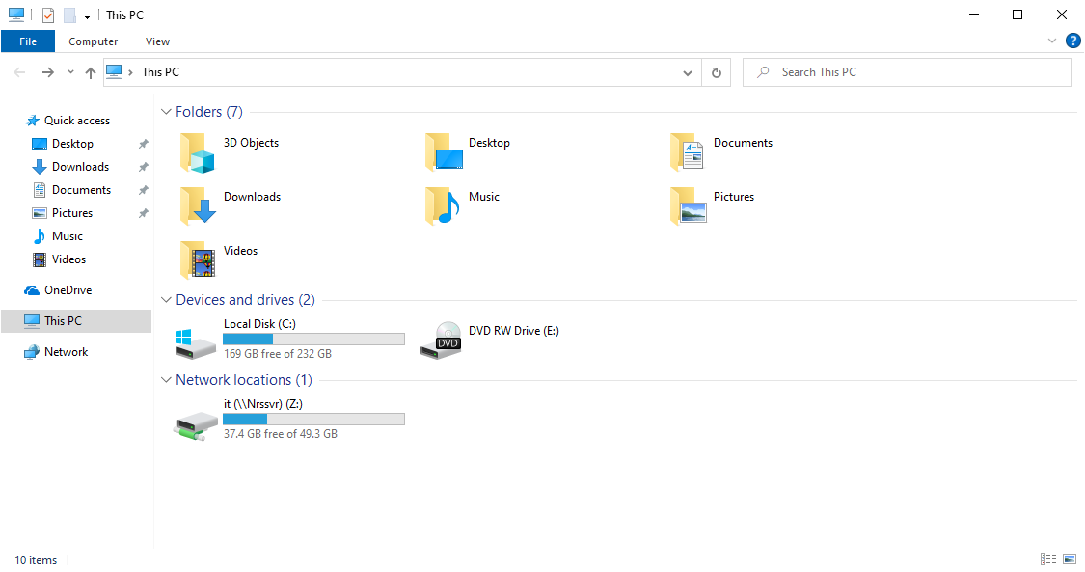
New network architecture
shared folder access for the domain user of IT department

Slide 70
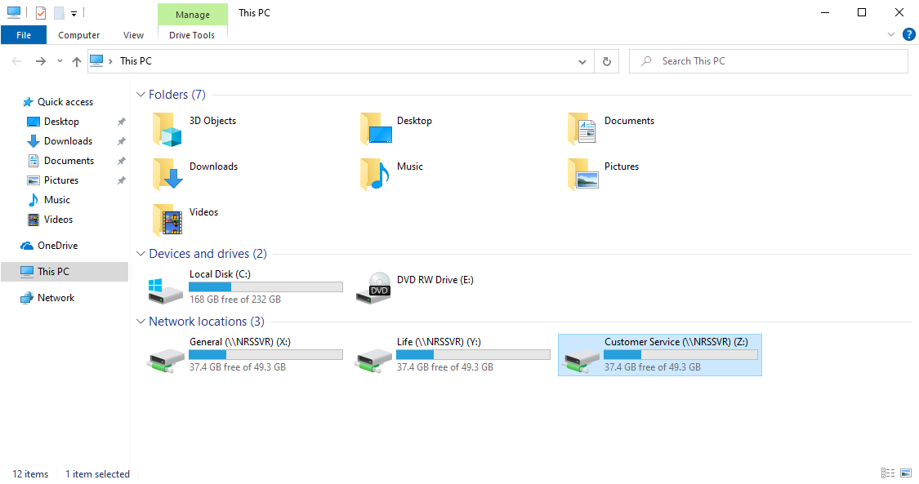
New network architecture
Shared folder access for the domain user of Customer Service department. In fact, Customer Service, Life and General department having the same level of permission access. Therefore, they can use their credential to access Life and General department.

Slide 71
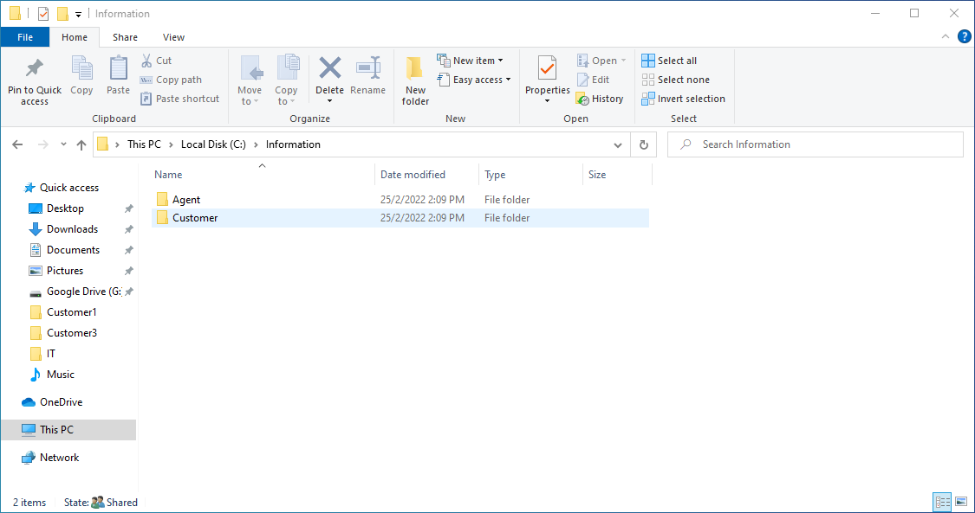
New network architecture
Google Drive Directory for Dedicated Agents & Customers within Server NRSSVR

Slide 72
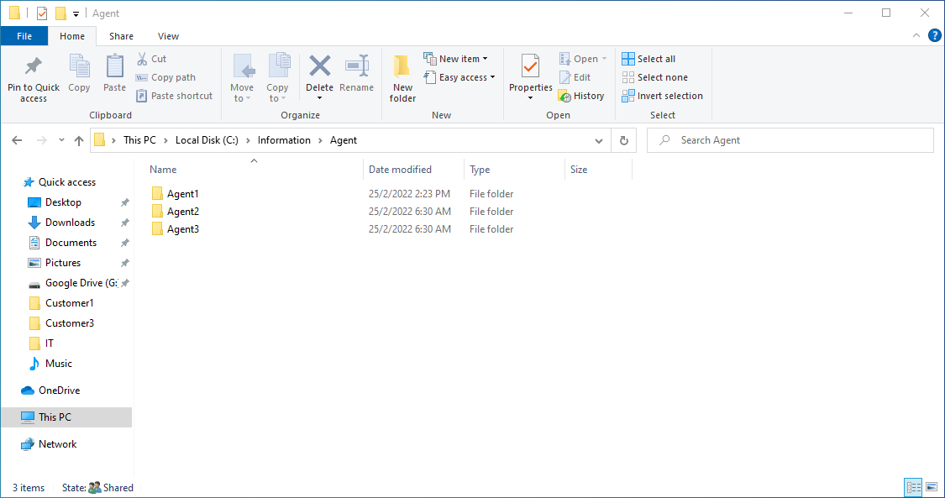
New network architecture
Google Drive Directory for Dedicated Agents & Customers within Server NRSSVR

Slide 73
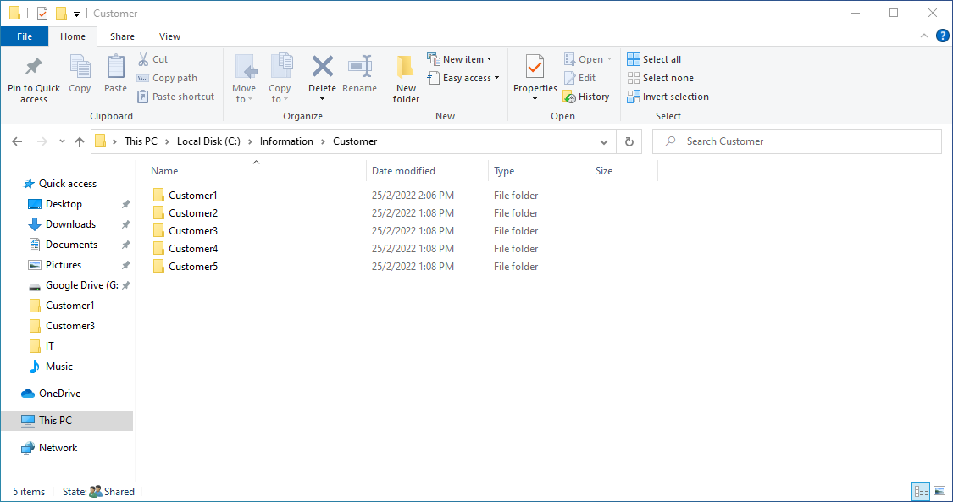
New network architecture
Google Drive Directory for Dedicated Agents & Customers within Server NRSSVR

Slide 74
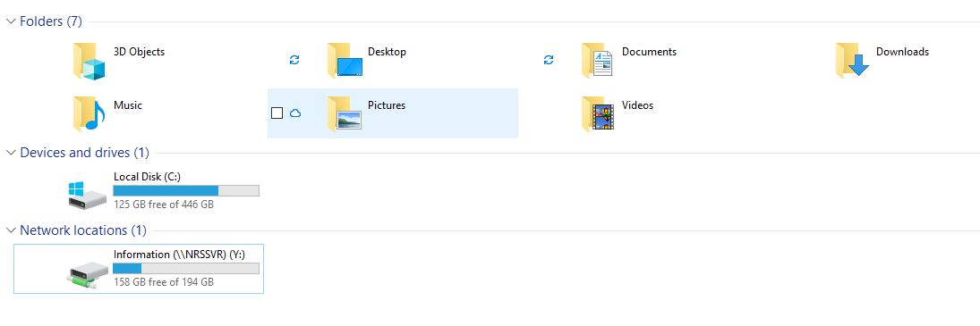
New network architecture
Google Drive Directory Access for Dedicated Agents & Customers for Internal Staff

Slide 75
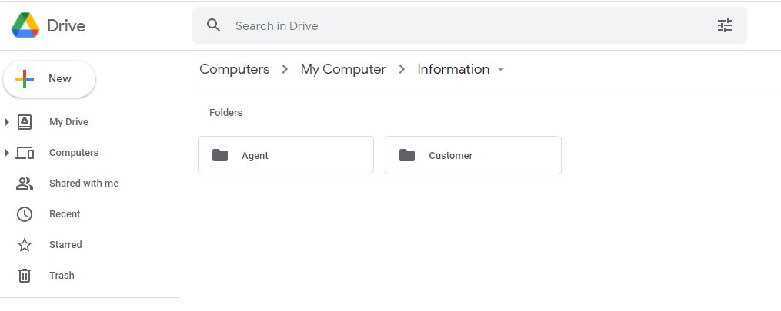
New network architecture
Folder for Dedicated Agents & Customers within Google Drive

Slide 76
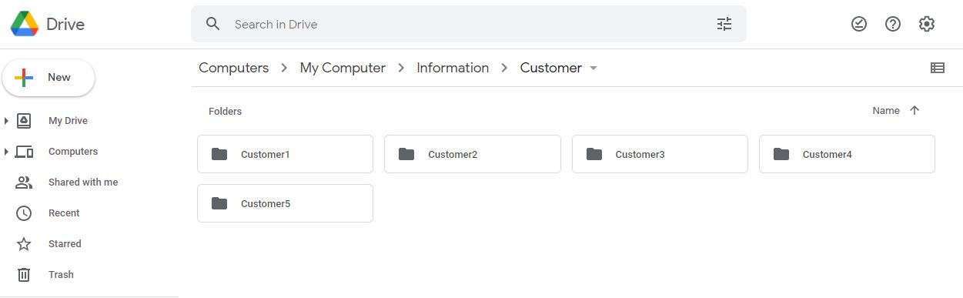
New network architecture
Folder for Dedicated Agents & Customers within Google Drive

Slide 77
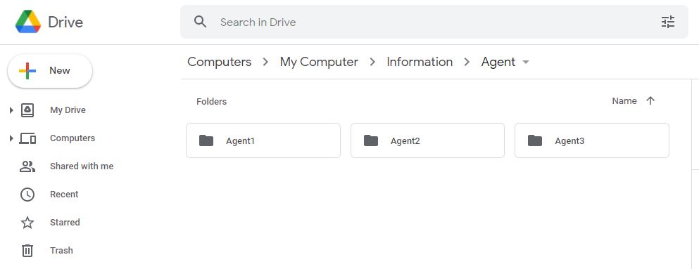
New network architecture
Folder for Dedicated Agents & Customers within Google Drive

Slide 78
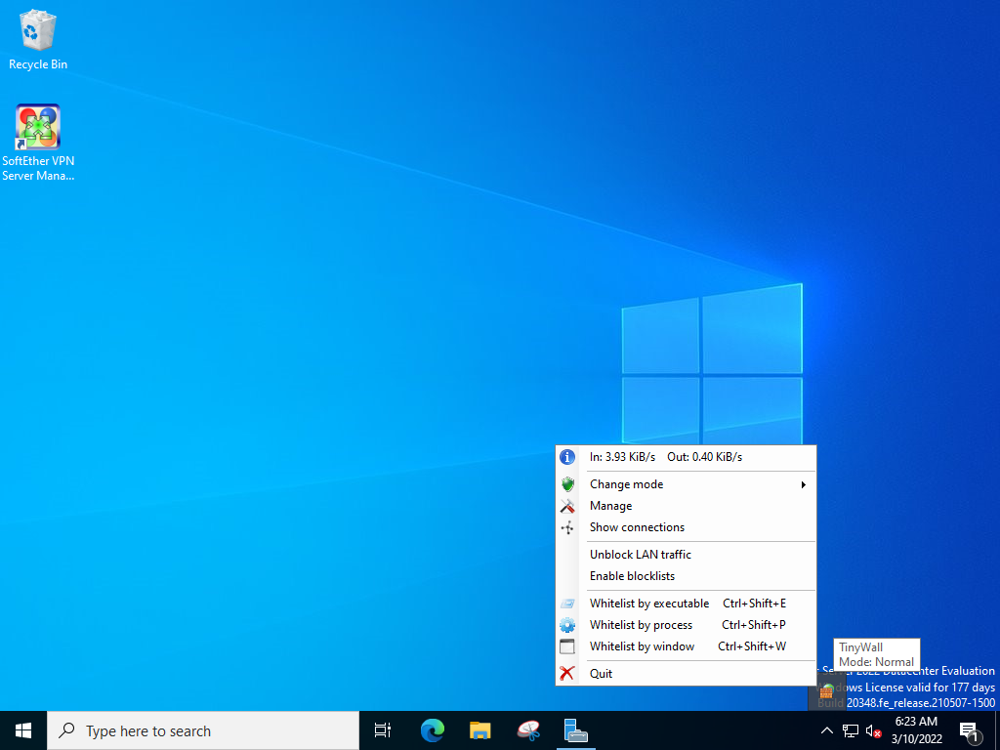
New network architecture
Service of TinyWall has started

Slide 79
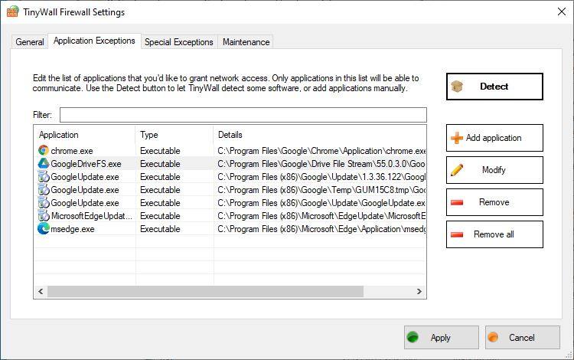
New network architecture
Server NRSSVR is able to access to the internet when the browser is inthe application exception list

Slide 80
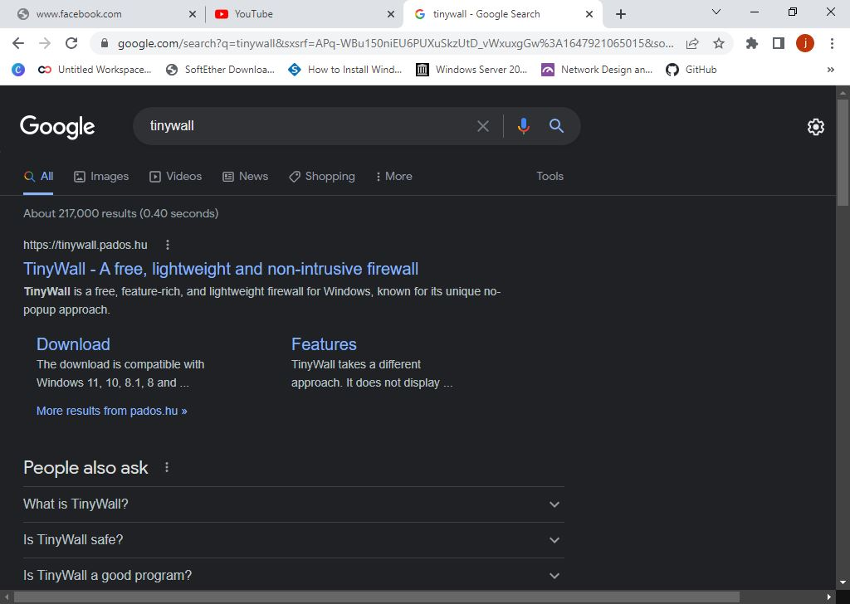
New network architecture
Server NRSSVR is able to access to the internet when the browser is inthe application exception list

Slide 81
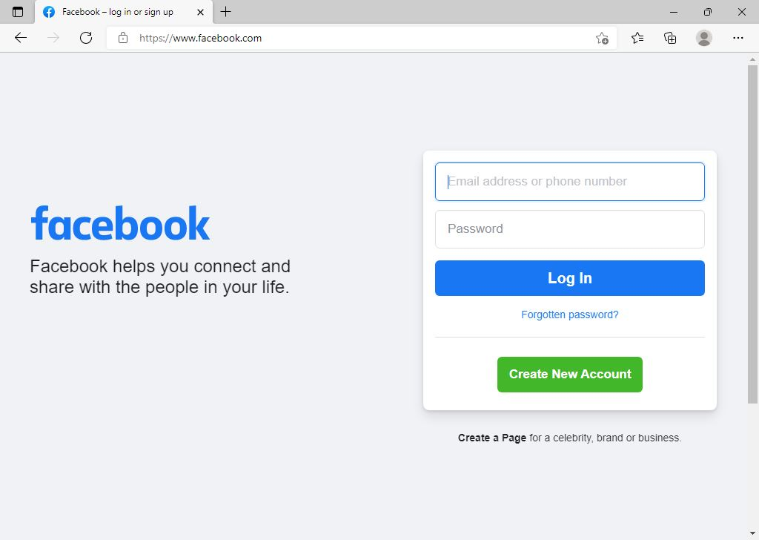
New network architecture
Server NRSSVR is able to access to the internet when the browser is inthe application exception list

Slide 82
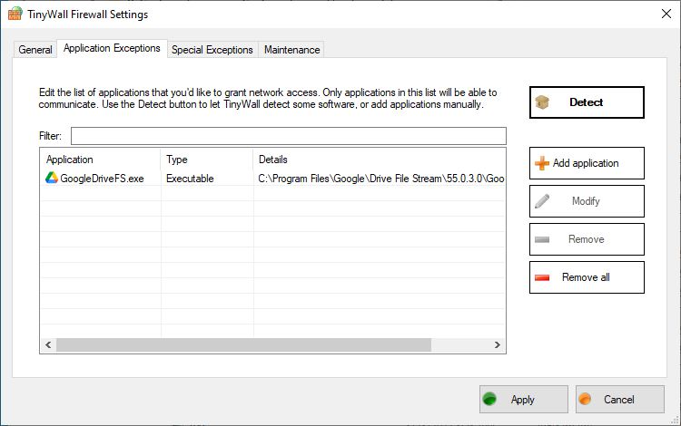
New network architecture
Server NRSSVR is not able to access to the internet when the browser is not in the application exception list

Slide 83
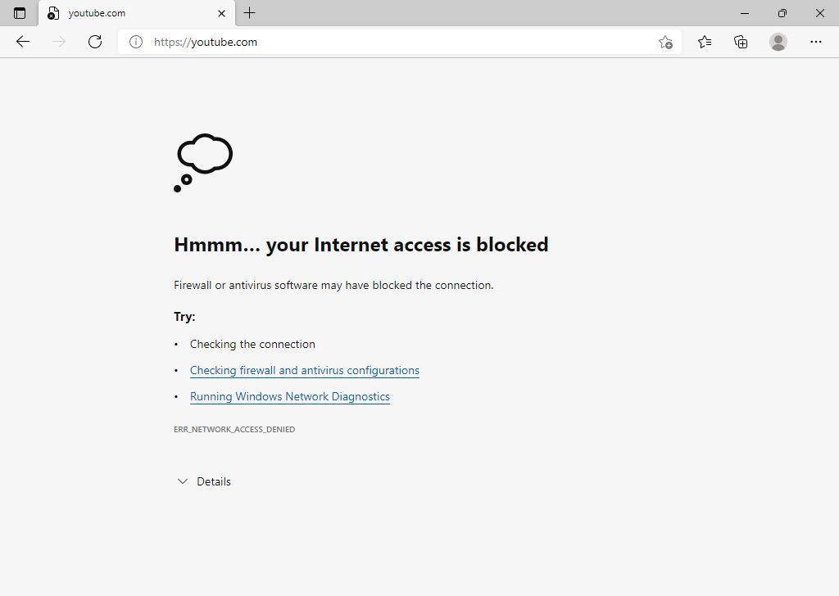
New network architecture
Server NRSSVR is not able to access to the internet when the browser is not in the application exception list

Slide 84

New network architecture
Server NRSSVR is not able to access to the internet when the browser is not in the application exception list

Slide 85
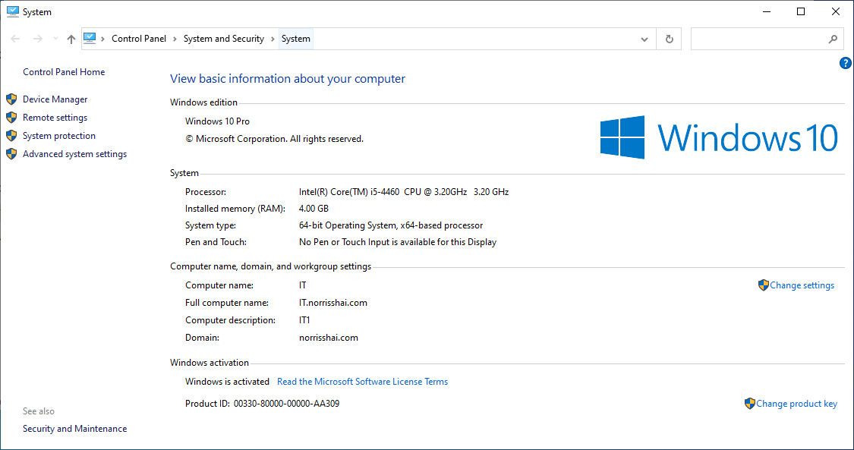
User testing
Login of the users successfully login into the domain and able to access the shared folder of their own department

Slide 86
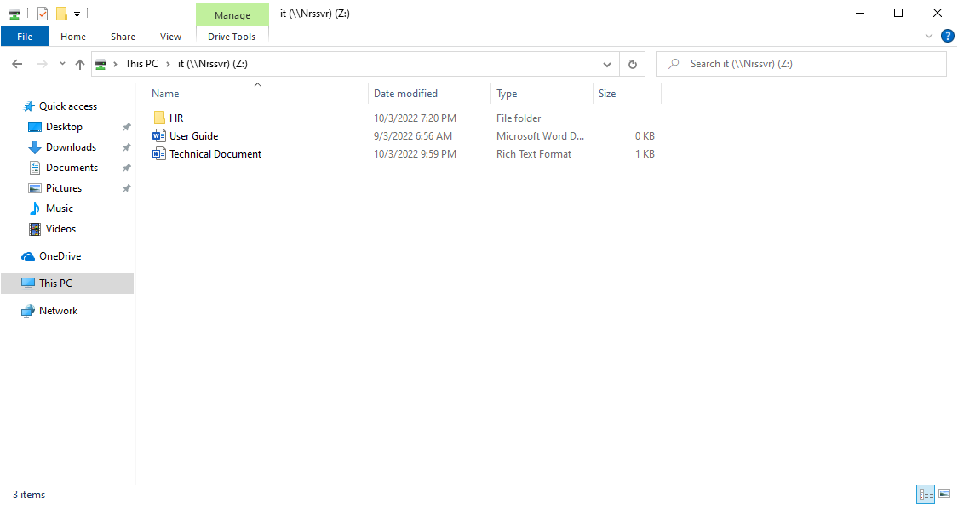
User testing
Login of the users successfully login into the domain and able to access the shared folder of their own department

Slide 87
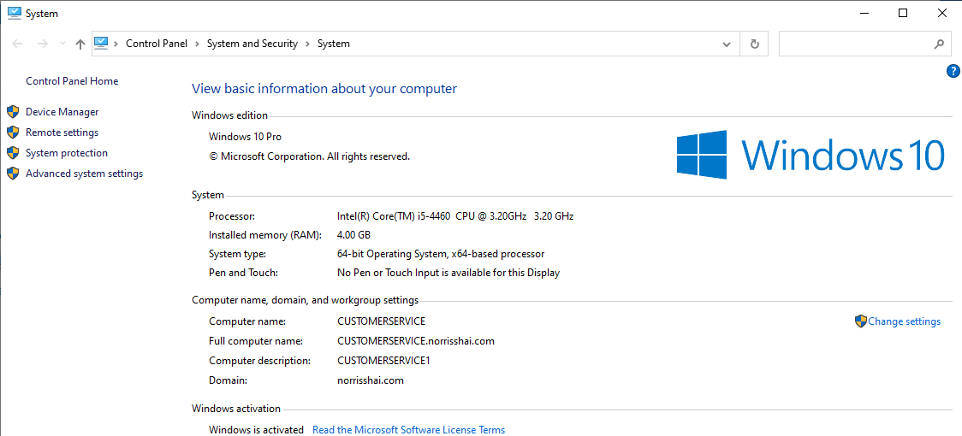
User testing
Login of the users successfully login into the domain and able to access the shared folder of their own department

Slide 88
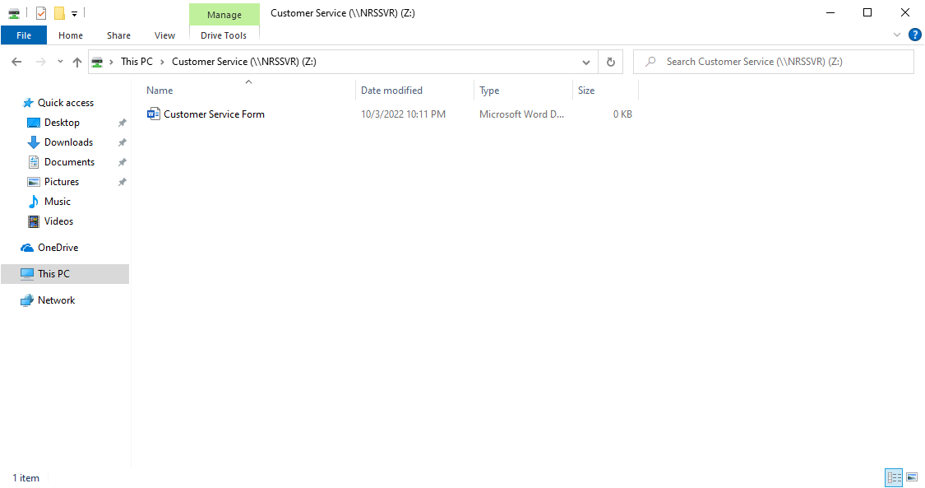
User testing
Login of the users successfully login into the domain and able to access the shared folder of their own department

Slide 89
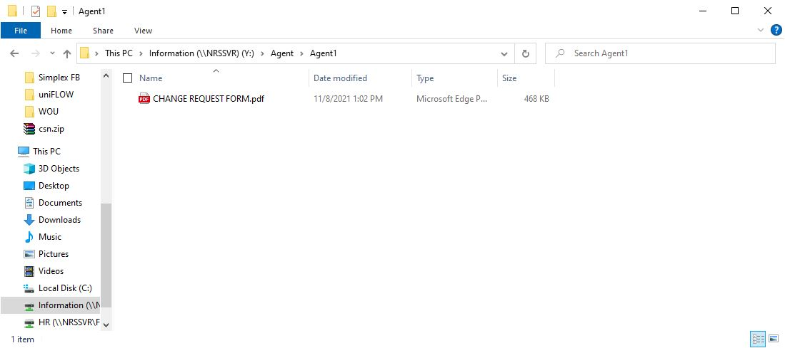
User testing
File sharing to Dedicated Agents is successful

Slide 90
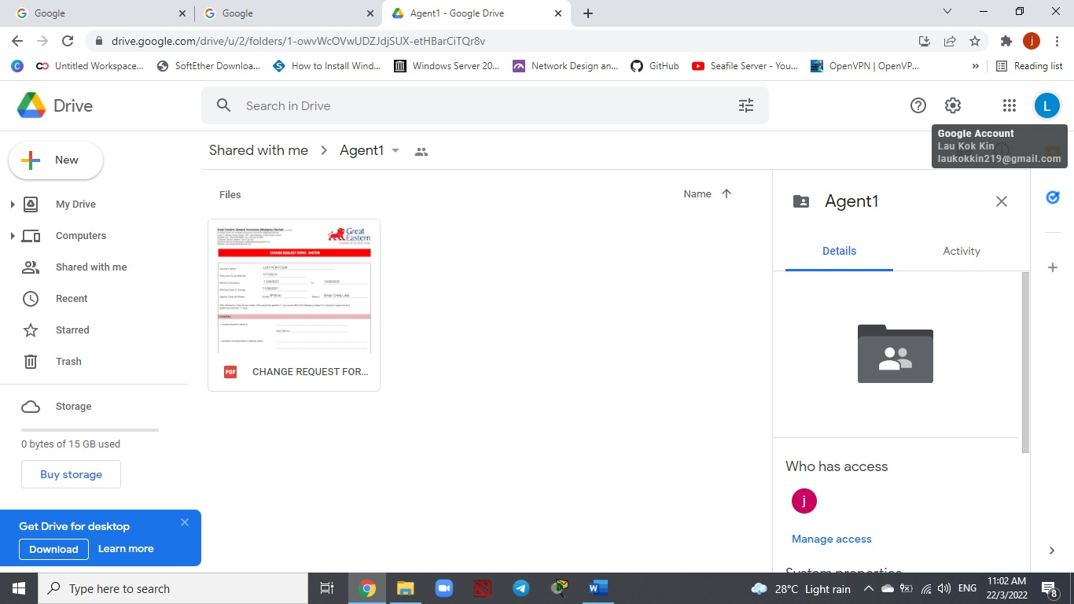
User testing
File sharing to Dedicated Agents is successful

Slide 91
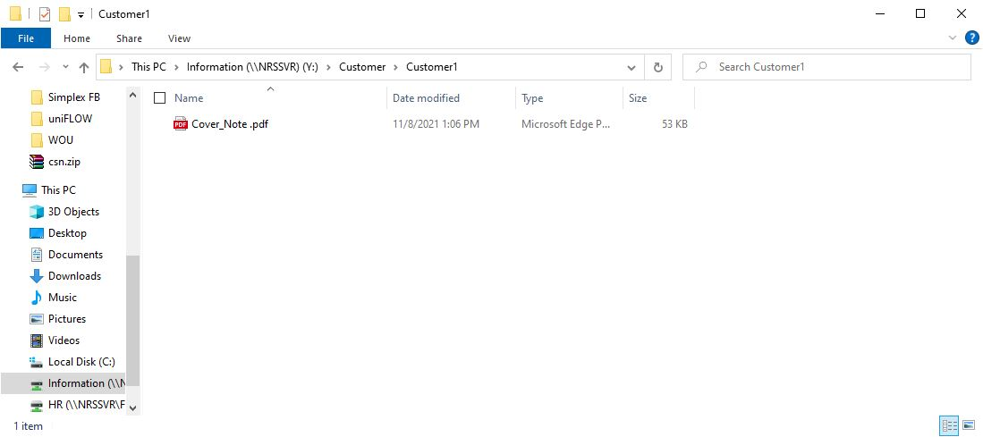
User testing
File sharing to Dedicated Customers is successful

Slide 92
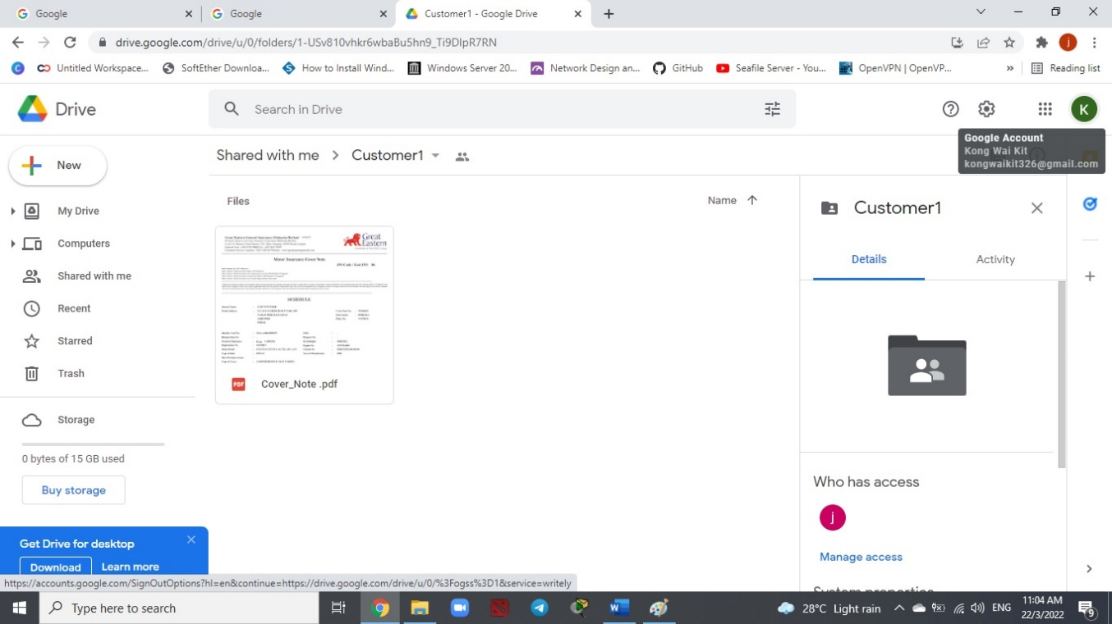
User testing
File sharing to Dedicated Customers is successful

Slide 93
User testing
The connection to VPN Server is successful and able to get through the network folder as well as the document within the server (NRSSVR)

Slide 94
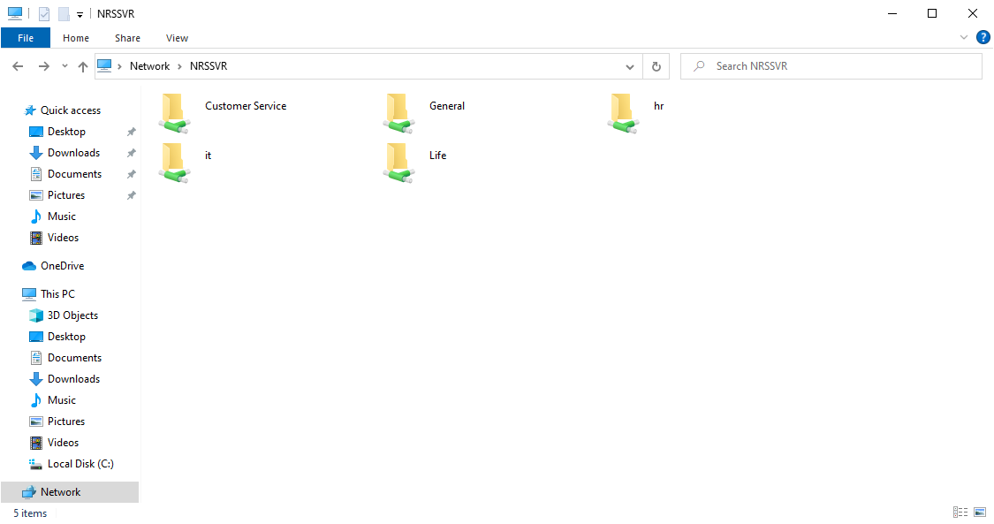
User testing
The connection to VPN Server is successful and able to get through the network folder as well as the document within the server (NRSSVR)

Slide 95
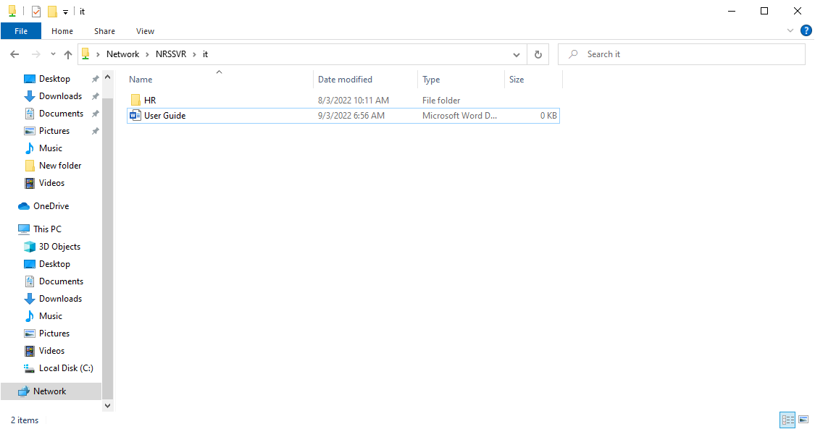
User testing
The connection to VPN Server is successful and able to get through the network folder as well as the document within the server (NRSSVR)

Slide 96
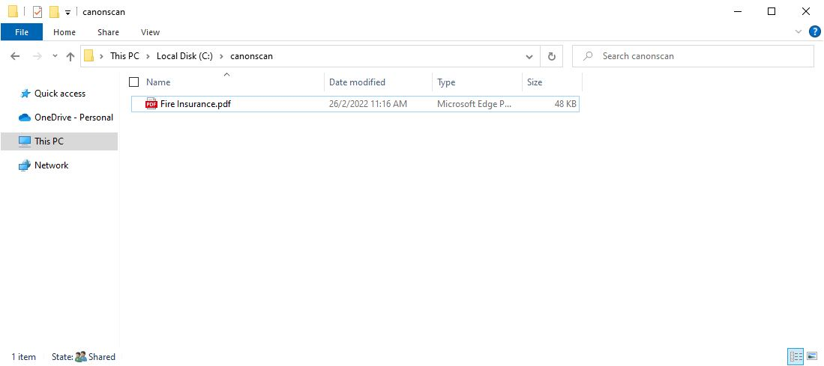
User testing
Scanning for the internal staff is successful. In this case, the staff able to store the documents into NRSSVR for future use. Besides, the remote user interface of the photostat machine able to record of the usage for each department which including the total print, copy as well as the scan record for each department respectively

Slide 97
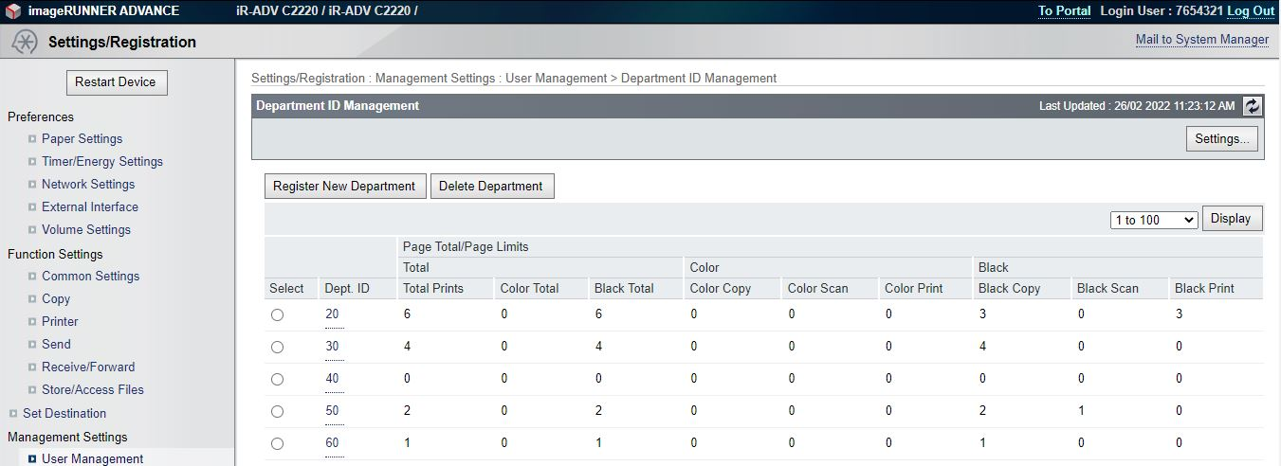
User testing
Scanning for the internal staff is successful. In this case, the staff able to store the documents into NRSSVR for future use. Besides, the remote user interface of the photostat machine able to record of the usage for each department which including the total print, copy as well as the scan record for each department respectively

Slide 98
User review
After the user testing, most of the staff, dedicated agents and customer as well as the boss reviews that the overall performance is good. Just that need some time to familiar with the new system

Slide 99
Conclusion and recommendation

Slide 100
conclusion
Create a great environment for the company
Productivity has increase
Daily task perform more systematic and more efficient

Slide 101
recommendation
Using of VPN Router
Hardware is always a better than software when compared to VPN router
Able to protect multiple network devices (computers, smartphones and tablets) at once
Quality of Service (QoS)
Optimize the performance of multiple applications within the network
Changing the ways of the data packet route over the internet or other internet to avoid transmission delay
Prioritize the traffic of the organization

Slide 102
The end

Slide 103
appendix
Youtube Presentation Link
https://youtu.be/EqkjcwGrCw8
Github File Link

